Slide 1
MICROPLANNING FOR
COVID-19 VACCINE DELIVERY
IN HEALTH CENTERS
JANUARY 2021

Slide 2
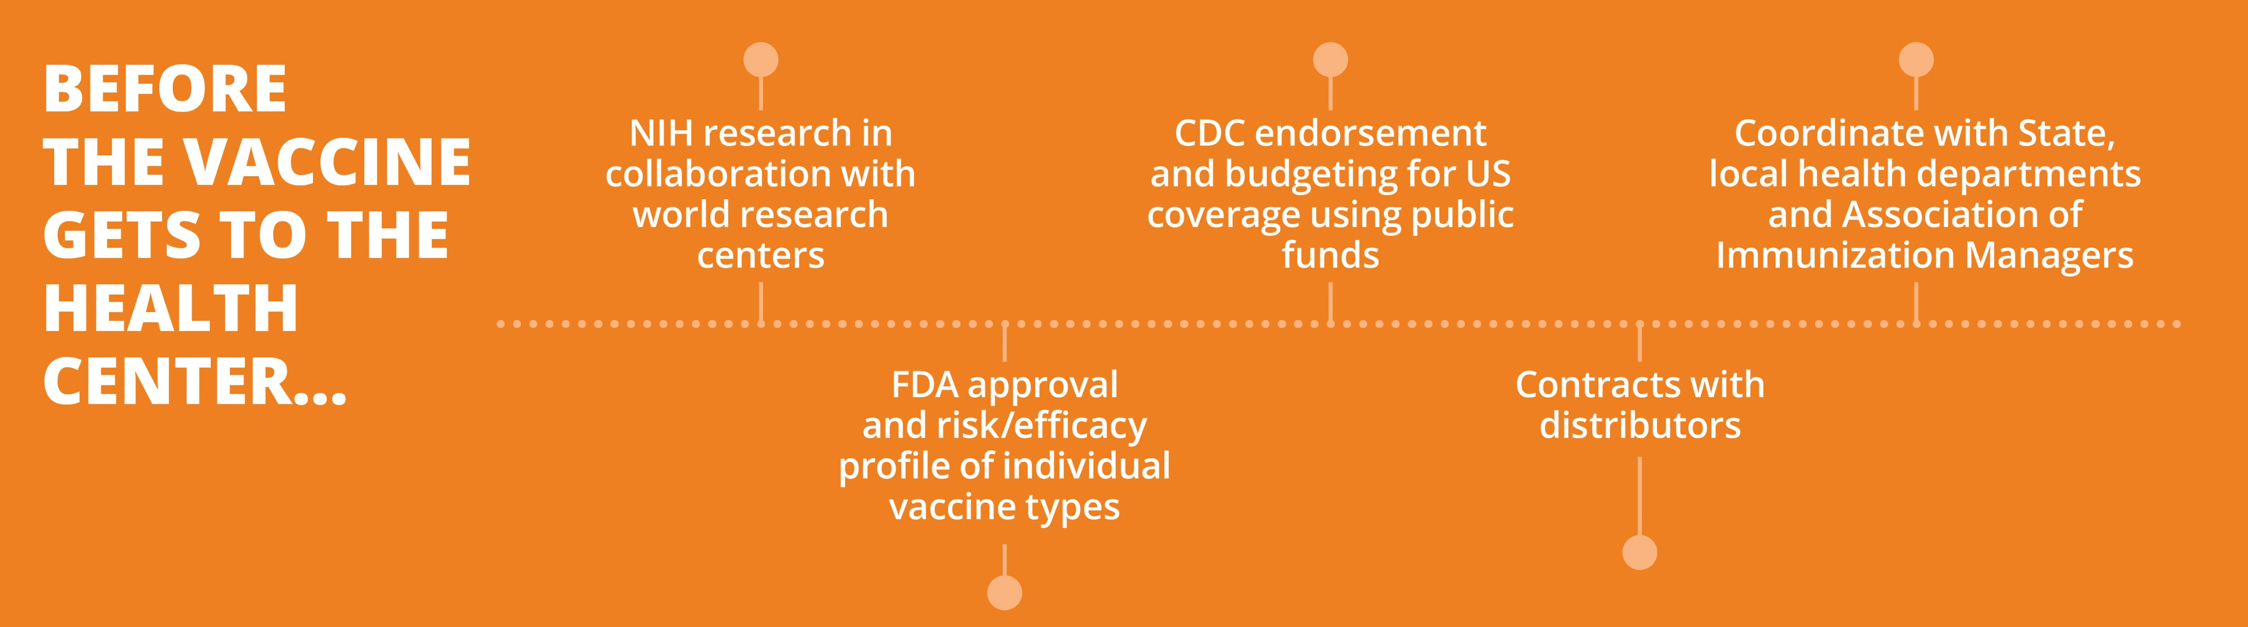
MICROPLANNING FOR
COVID-19 VACCINE DELIVERY
IN HEALTH CENTERS

Slide 3
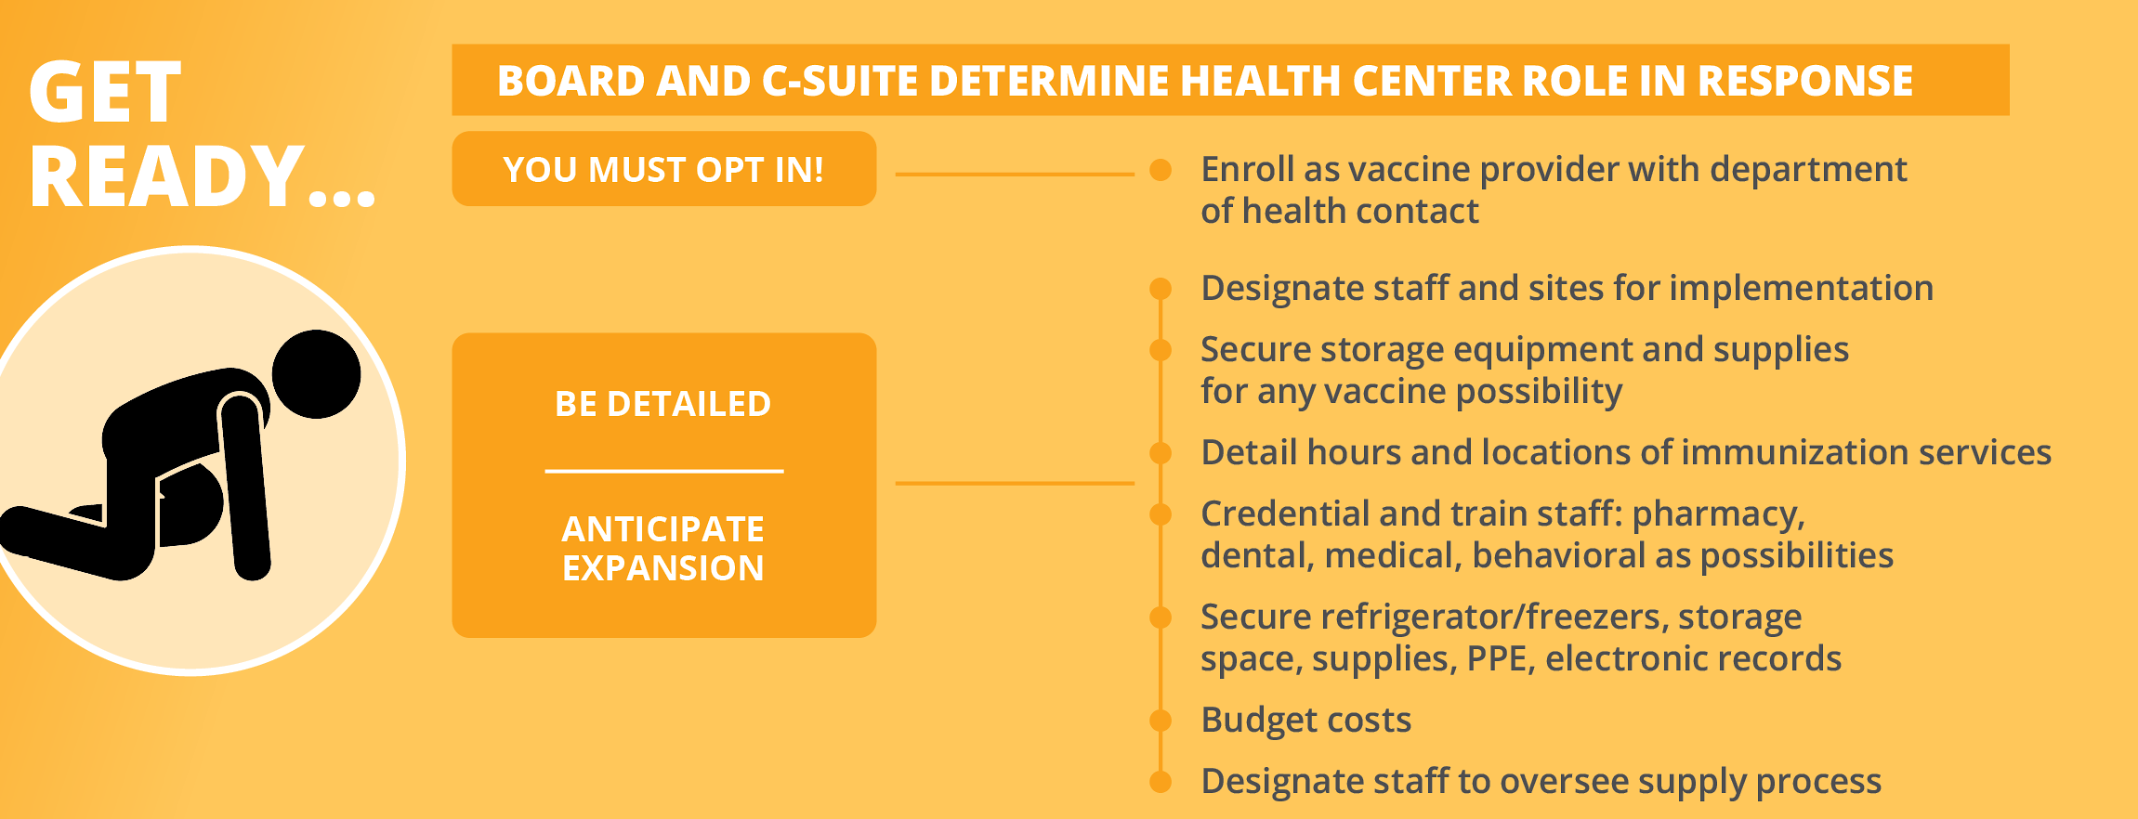
MICROPLANNING FOR
COVID-19 VACCINE DELIVERY
IN HEALTH CENTERS

Slide 4

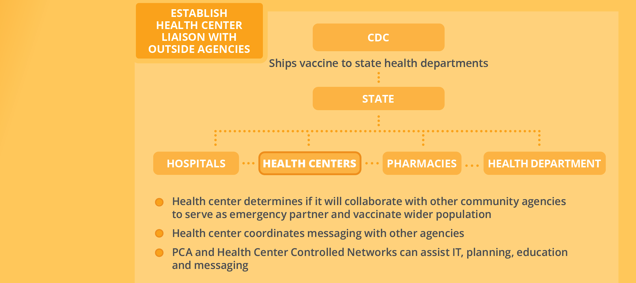
MICROPLANNING FOR
COVID-19 VACCINE DELIVERY
IN HEALTH CENTERS

Slide 5
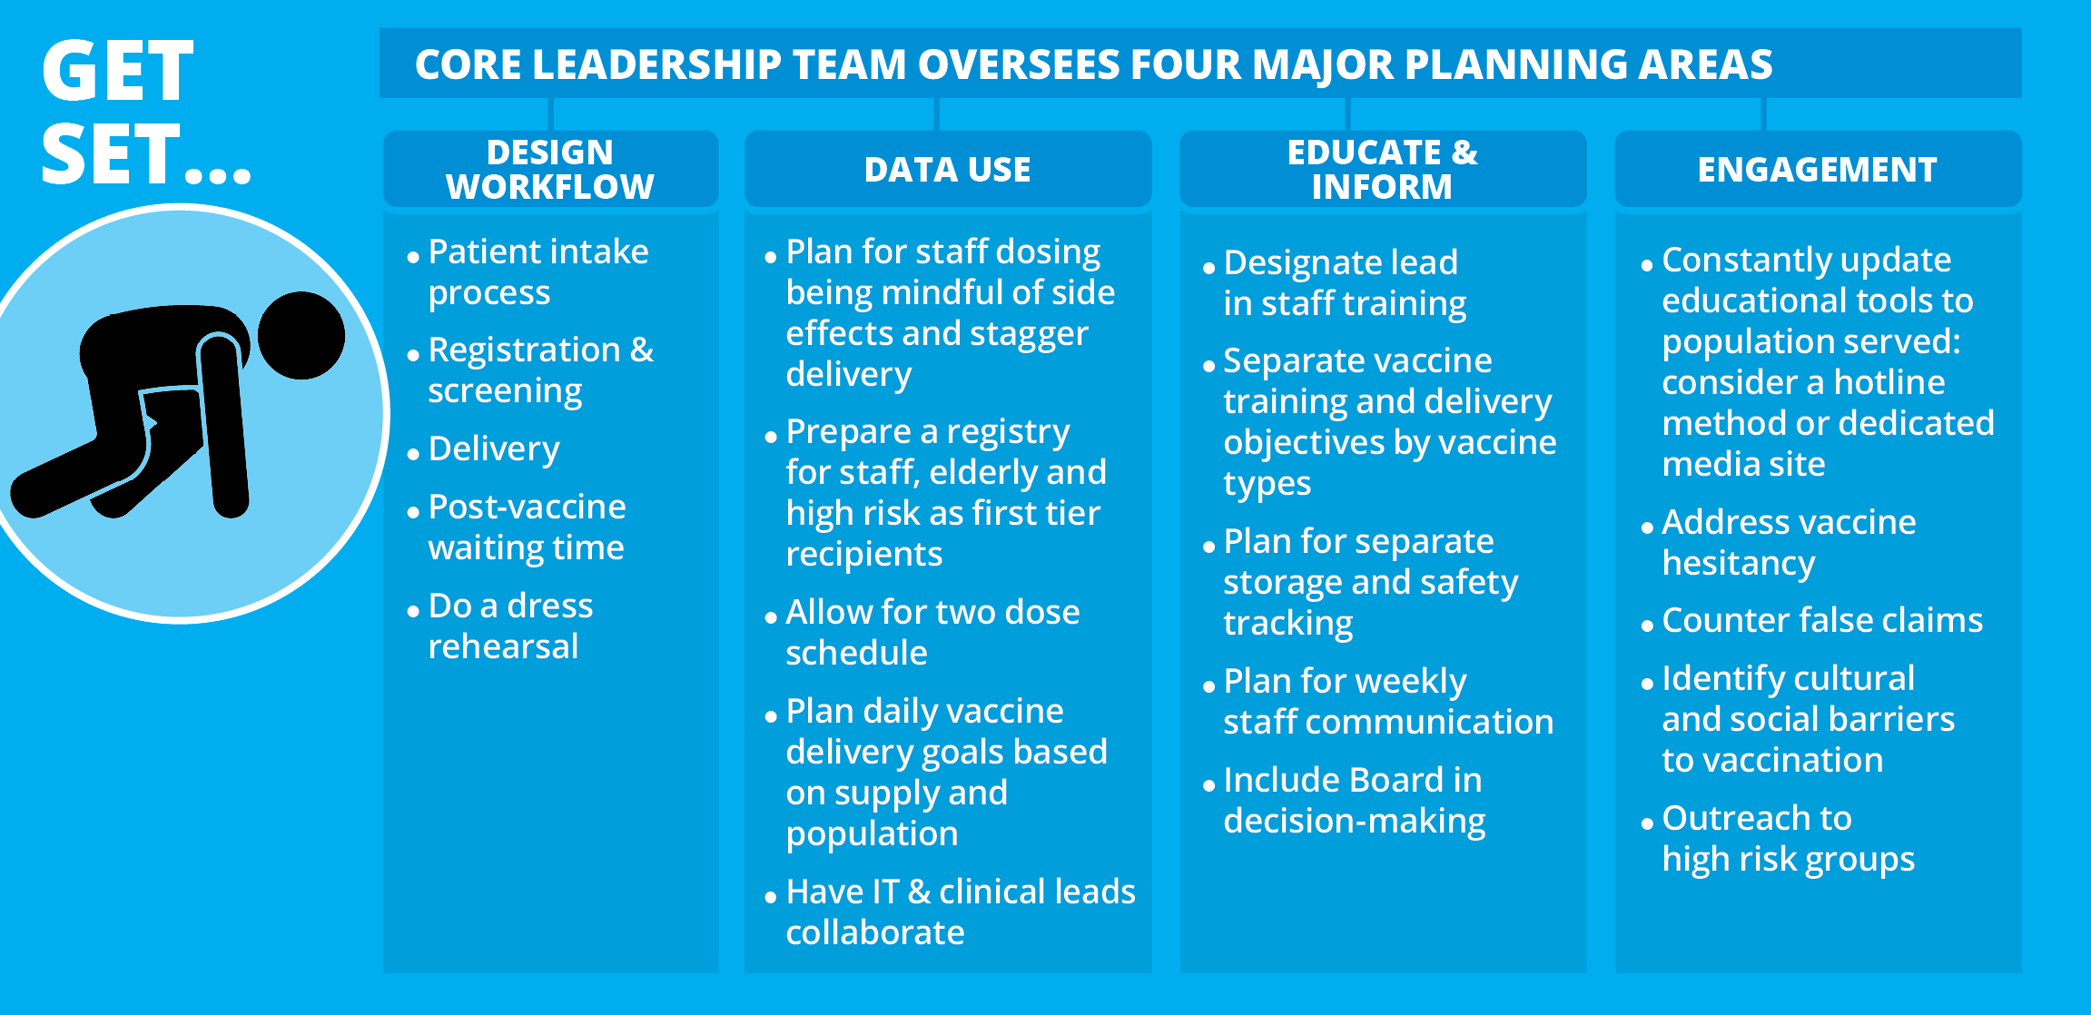
MICROPLANNING FOR
COVID-19 VACCINE DELIVERY
IN HEALTH CENTERS

Slide 6
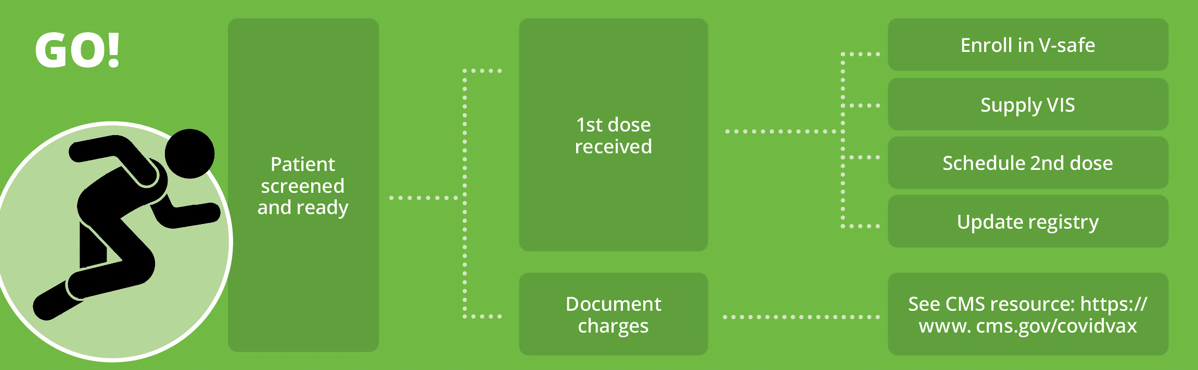
MICROPLANNING FOR
COVID-19 VACCINE DELIVERY
IN HEALTH CENTERS

Slide 7
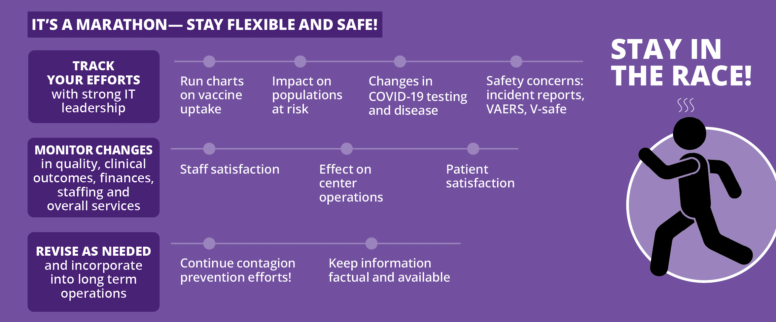
MICROPLANNING FOR
COVID-19 VACCINE DELIVERY
IN HEALTH CENTERS

Slide 8
MICROPLANNING FOR
COVID-19 VACCINE DELIVERY
IN HEALTH CENTERS

Slide 9

MICROPLANNING FOR
COVID-19 VACCINE DELIVERY
IN HEALTH CENTERS
RESOURCES FOR MICROPLANNING
MODERNA VACCINE INFORMATION, STORAGE AND HANDLING:
https://www.fda.gov/media/144434/download
PFIZER VACCINE INFORMATION, STORAGE AND HANDLING:
https://www.fda.gov/emergency-preparedness-and-response/coronavirus-disease-2019-covid-19/pfizer-biontech-covid-19-vaccine
CMS REIMBURSEMENT GUIDELINES:
https://www.cms.gov/covidvax
VACCINE SAFETY REPORTING:
VAERS.hhs.gov; CDC.gov/vsafe
VACCINE TRAINING AND TOOLKIT FOR HEALTHCARE PROFESSIONALS:
https://www.cdc.gov/vaccines/covid-19/hcp/index.html

Slide 10
MICROPLANNING FOR
COVID-19 VACCINE DELIVERY
IN HEALTH CENTERS
TOP TEN FAQS
If someone has had COVID-19 can they get immunized? | Yes. Some suggest a 90 day waiting period from time of infection so that a robust immune response will occur
Is there a role for COVID-19 antibody testing? | Not at this time
Is there a role for COVID-19 testing? | If suspicion of COVID-19 infection is present, testing is indicated. Vaccine should not be given to people with active infection
Can you get COVID-19 infection from the vaccination? | No, the vaccine tells your body to make a protein against the virus. The virus itself is not in the vaccine, just a messenger for it that acts as a trigger to your immune system
Are vaccine side effects similar to the symptoms of infection? | Not really. Side effects are symptoms of your immune system at work making antibody. They include fatigue, soreness, headache and possible fever. They do not include cough, shortness of breath, sore throat or fever more than two days. Side effects are milder in the elderly, the opposite of infection.
Can immunocompromised people get vaccinated? | Yes. It is not a live virus vaccine. That said, the idea is to mount an immune response, so the person’s health care provider should determine if that is likely in the individual situation.

Slide 11
MICROPLANNING FOR
COVID-19 VACCINE DELIVERY
IN HEALTH CENTERS
TOP TEN FAQS (continued)
If someone has an allergy to food, medicine or a previous vaccine, should they get the shot? | People with allergies have a higher risk of an allergic reaction to the vaccine. They should be monitored throughout the vaccine delivery if they get a shot, with appropriate medication and support available to them in the event of a reaction. A determination of relative risk is important in deciding if a vaccine is the right choice.
Should we prioritize giving everyone 1 shot or assuring that a smaller group gets two doses? | Prioritize completing the 2 dose series and do not vaccinate people you can’t follow up. Data on effectiveness depends on 2 shots being completed. Note that side effects are usually worse with the second dose, indicating that a good immune response is occurring
How long does immunity from the vaccine last? | We only know it lasts as long as it has been tested thus far, which is at least 4-6 months. Testing will continue in the original group of vaccinees and will tell us more with time. The same goes with immunity from natural infection—we do know that some people have caught COVID-19 twice.
Will mutations in the virus make vaccines ineffective? | There is no evidence that mutations in this virus change vaccine effectiveness. COVID-19 mutates more slowly than flu and with less significance to overall function. Vaccine targets preventing infection by the virus. The mutations have not addressed that feature.

